Slide 1
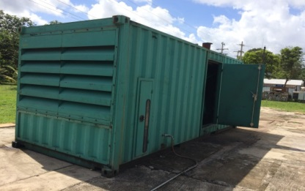
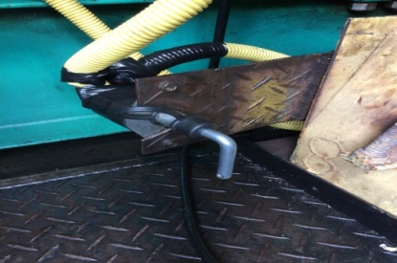
HS&E INCIDENT BULLETIN |  | 1st half year 2017
Muana, Brazil | Type of incident (Respiratory – Inhalation)
Summary:
An employee was inspecting cables of an engine that had not been operating due to operational instability (safety protections were not working). The employee opened the container doors, switched off the battery safety key, and headed out to the panel to check the cables. After approx. 5 minutes, he noticed a smell, but continued working. Only when he felt a burning sensation in his eyes did he leave the area and walk around the container to see what was occurring. Then, he noticed vapor/smoke releasing from a sealed battery. The employee experienced dizziness, nausea and shortness of breath. The battery had no visual damage.
Root Causes: | Actions Taken Thus Far: Next Steps
Still under investigation. The battery was sent to the manufacturer for technical testing. We are awaiting their response. | The employee removed clothing, washed his body and eyes and was taken to a nearby hospital to receive oxygen. Review the existing risk assessment (HIRA) to ensure all potential hazards are identified with control measures. Refresh all employees on hazard identification awareness. Use current clamp meter to check power supply before starting any electrical activity. Use smoke detectors to reduce the risk of incidents.
Container of the engine – The batteries sit in front of the door
Damaged battery; right side valve that reportedly released the vapor
Battery safety key – on the open position

